Slide 1
Single-cell multimodal integration
Predicting single-cell gene expression from chromatin accessibility with multi-layer perceptron and truncated singular value decomposition.

Slide 2
About dataset
Input: chromatin accessibility (row: cell, column: chromosome locations)
Target: gene expression (row: cell, column: genes), library-size normalized log1p
Extreme sparsity: 2% non-zero values;
High dimensionality: 229k for input, 23k for output;
(105942, 228942) -> (105942, 23418)

Slide 3
Preprocessing (input)
80-20 fixed training-validation split
Compression: convert to sparse matrix data type to save memory
Binarization: non-zero entries = 1, improves performance
tSVD dimensionality reduction: remove sparsity, concentrate information
Normalization: divide by row-wise mean
Non-negative matrix factorization and autoencoder: computationally expensive

Slide 4
Preprocessing (target)
80-20 fixed training-validation split
Compression: convert to sparse matrix data type to save memory
Scanpy highly variable gene (HVG) selection: compensatory model, 2048 in total
Normalization: divide by non-zero row-wise mean
tSVD on target data limits the ceiling of performance

Slide 5
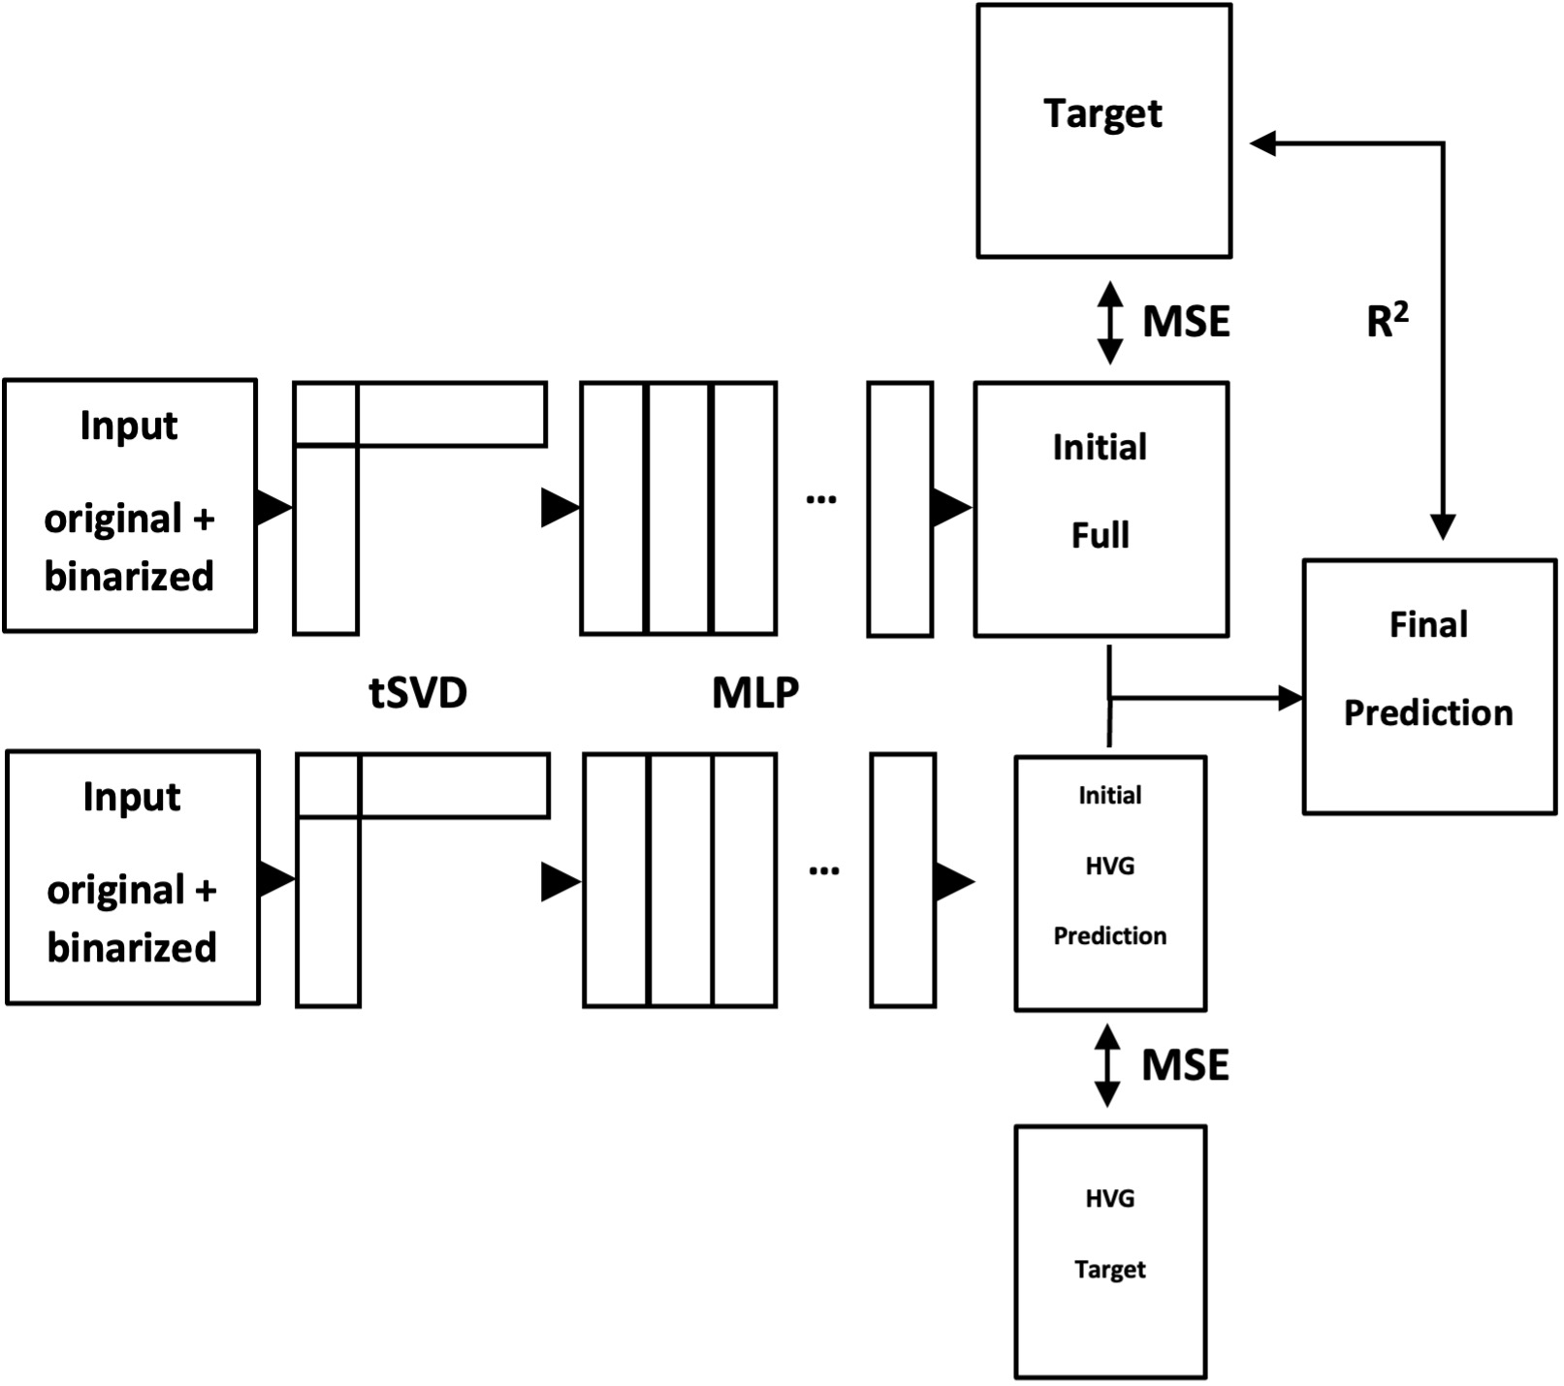
Model architecture

Slide 6
Training
MLP1: 6-layer network with ReLU, BatchNorm and Dropout, hidden size: 2048
MLP2: 6-layer network with ReLU, BatchNorm and Dropout, hidden size: 2048
Batch size: 256, 100 epochs
AdamW optimizer, ReduceLROnPlateau scheduler, MSELoss
Software: PyTorch + Sklearn, trained on Google Colab

Slide 7
Current Result
Metric: Pearson correlation coefficient (self-implemented vectorized version)
MLP1: 0.66785, MLP2: 0.70221
My final score: 0.66838
Reference score: 0.670 (5th solution, not directly comparable)

Slide 8
Thank you.

